Slide 1
Solid state NMR
CHEM 3013 HPO

Slide 2
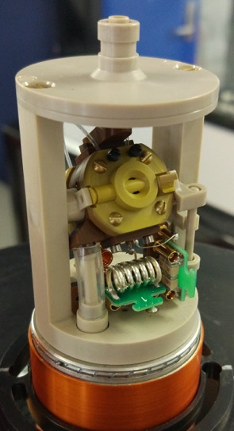
An exciting time to study NMR
Solid state NMR is complicated.
That complexity give spectra rich in structural information (not available in solution NMR)
Very recent advances solid state technology allow study of macromolecular solids.

Slide 3
Overview
Lecture 1: Anisotropic spin interactions
Lecture 2: Solids spectra and magic angle spinning
Lecture 3: NMR experiments for biosolids
Practical:
Tuning the magic angle with quadrupolar ⁷⁹Br
Shimming with silicone rubber
Compensating frictional heating
Cross-polarisation with a microcrystalline protein sample

Slide 4
Liquid vs. Solid state NMR
B₀

Slide 5
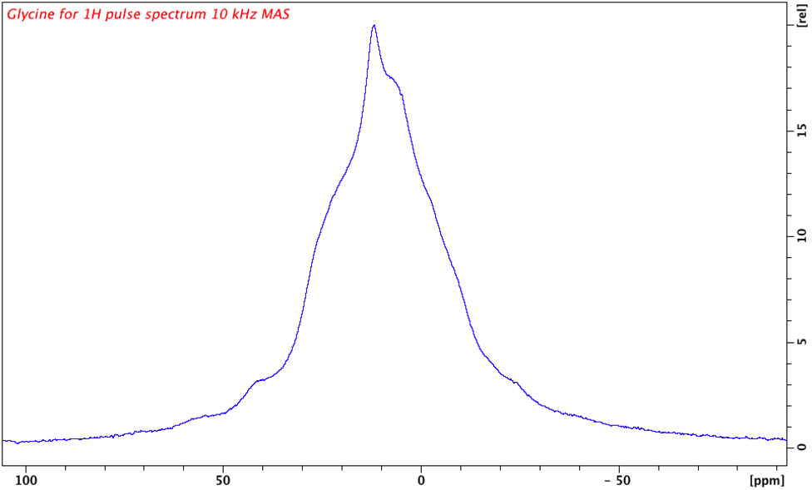
Liquid vs. Solid state NMR

Slide 6
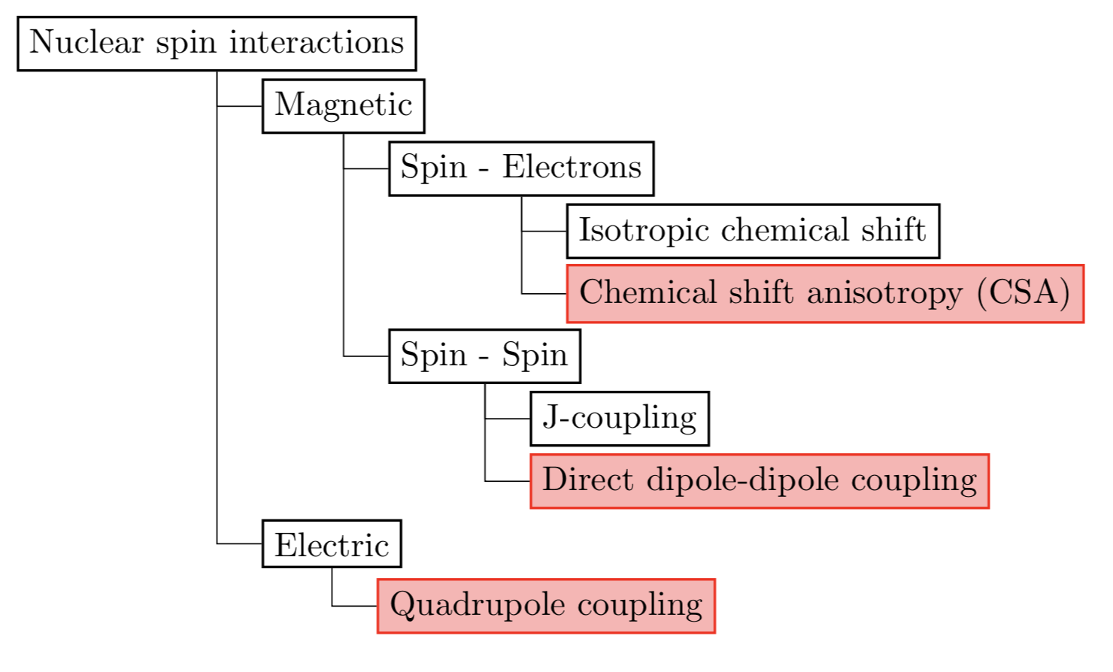

Slide 7

Chemical shift
B₀
electrons
Chemical shift is an indirect magnetic interaction between nuclear spin and the external magnetic field via the electrons

Slide 8
Direct dipole-dipole coupling
Two nuclear spins interact directly by their magnetic dipolar fields
Up to 20 kHz!

Slide 9
J-coupling
Also called indirect dipole-dipole coupling,
J-coupling is an indirect magnetic interaction between nuclear spins via the electrons
electrons
~ 50 Hz

Slide 10
Quadrupole coupling
electrons
Quadrupole coupling is an electric interaction of the non-spherical charge density of a nucleus with the electrons. This only applies for spin > 1/2
+
-

Slide 11
Anisotropic interactions
Isotropic: The magnitude is constant over all orientations
Anisotropic: The magnitude varies with orientation of the molecule with respect to the external magnetic field.
Spherical harmonics (same as molecular orbital theory)

Slide 12
A tensor basis for spatial functions
Fourier decomposition
Spherical harmonic decomposition
=

Slide 13
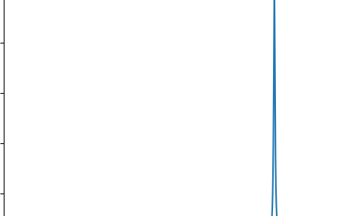
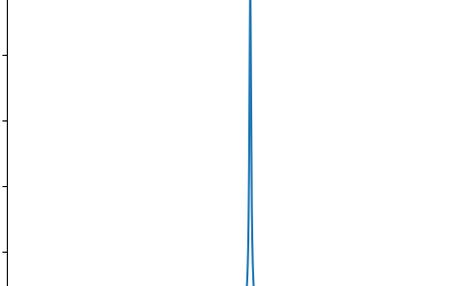
Chemical shift anisotropy (CSA)
Chemical shift depends on the orientation of the molecular orbitals with respect to the external magnetic field B₀
B₀
B₀
electrons
150 ppm
210 ppm

Slide 14
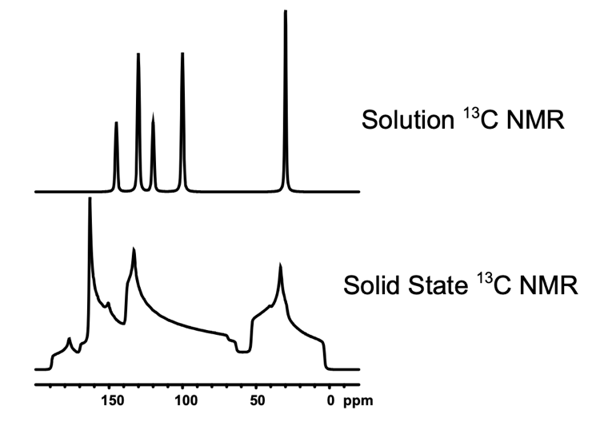
Chemical shift in an unordered ensemble
“Powder pattern”
This is like a histogram for the chemical shift of uniformly distributed molecular orientations over a sample.

Slide 15
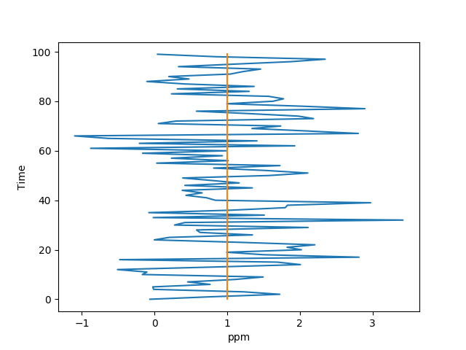
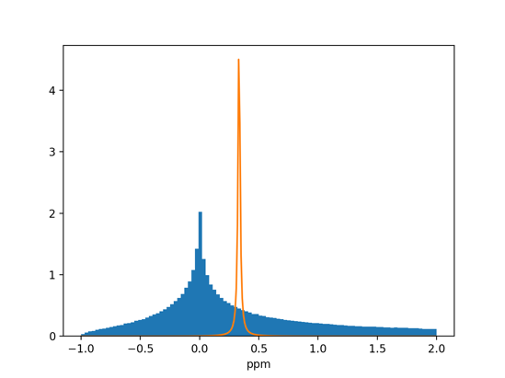
CSA not visible in solution NMR
Like fast-exchange, all chemical shifts are averaged on the time-scale of rotational tumbling.

Slide 16
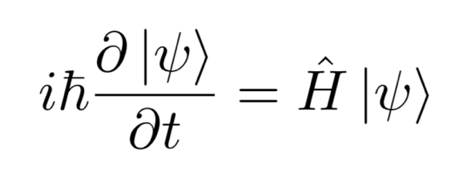
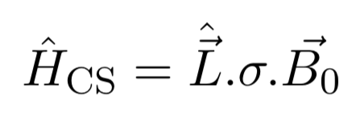
A tensor description of CSA
?

Slide 17
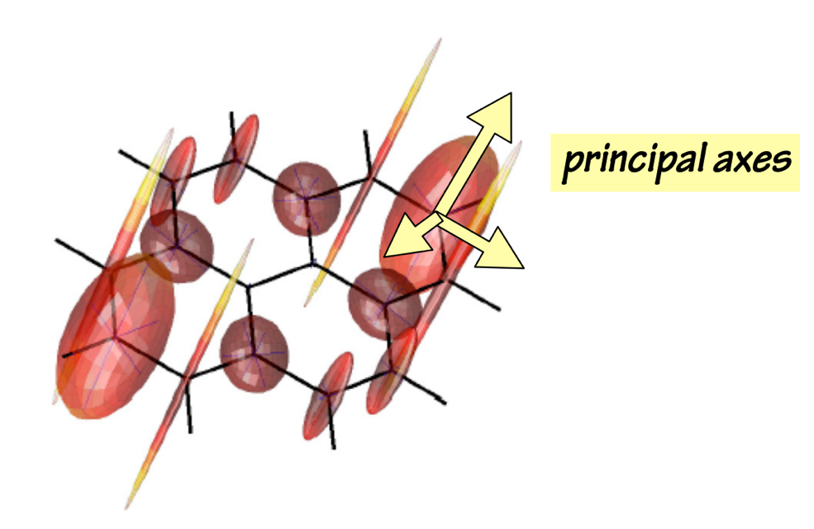
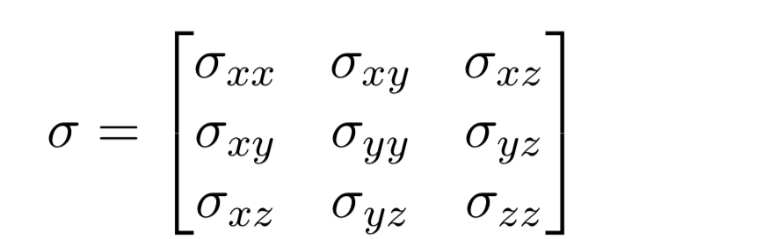
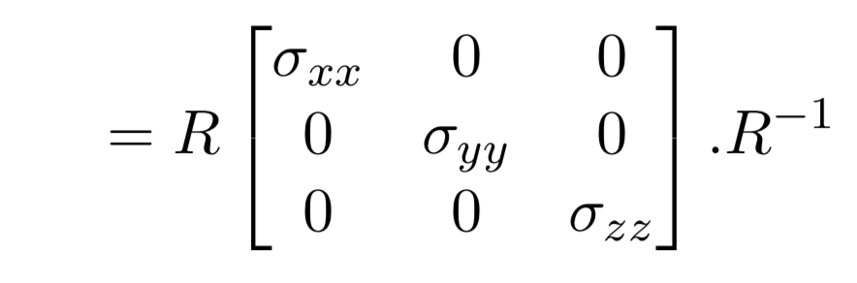
A tensor description of CSA

Slide 18
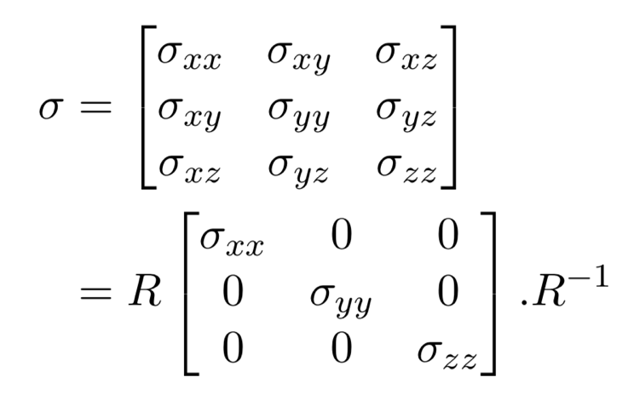
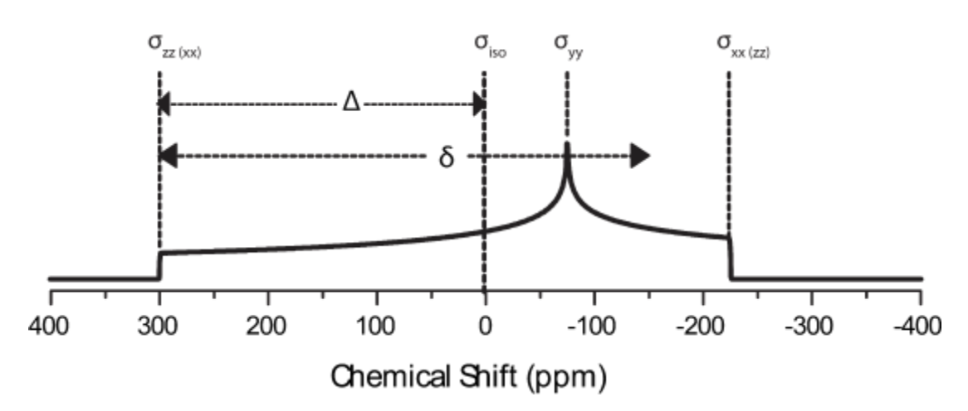
A tensor description of CSA

Slide 19
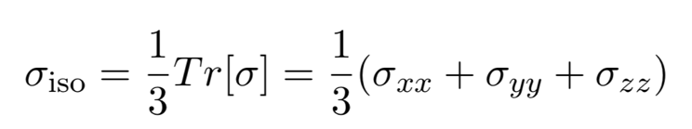
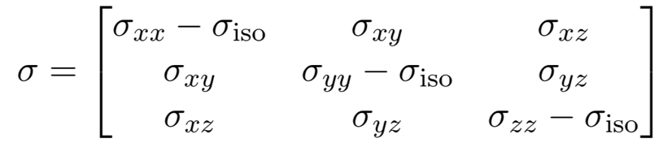
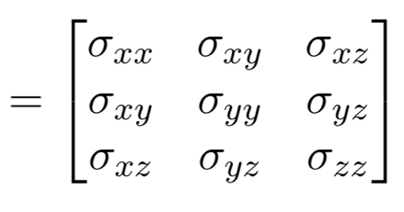
Isotropy and anisotropy
+

Slide 20
Direct dipole-dipole coupling
0° = -10 kHz
90° = 5 kHz
54.7° = 0 kHz
B₀

Slide 21
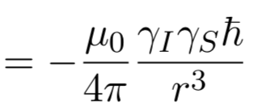
Direct dipole-dipole coupling anisotropy
“Pake pattern”
This is like a histogram for the coupling of uniformly distributed bond vector orientations over a sample.
H
H
H
H
H
H
d

Slide 22
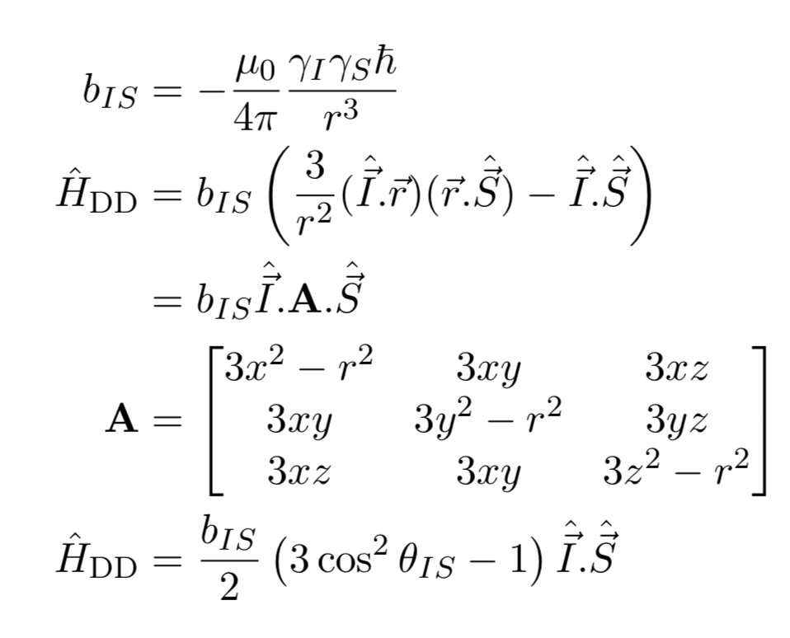
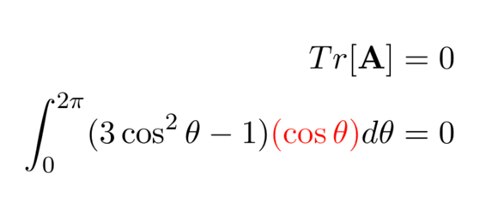
A tensor description of direct dipole-dipole coupling
Not observed in solution NMR!

Slide 23
Summary
In solution NMR we see isotropic interactions: chemical shift and j-coupling.
Anisotropic interactions are observable in solid state NMR: Chemical shift anisotropy, direct DD coupling, quadrupole coupling.
Anisotropic spin interactions can be described by spherical tensors.
A tensor has a matrix representation with principle axes.

